Slide 1
Data Structure
Lecture#04

Slide 2
Linked List
Linked list is a data structure used for storing collections of data
Linked list has the following properties
Successive elements are connected by pointers
Last element points to None
It can grow or shrink size during execution of a program
It can be made just as long as required
It does not waste memory space

Slide 3
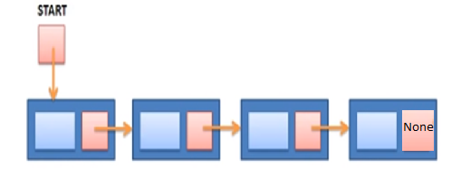
Linked List(cont.)

Slide 4
Linked List(cont.)
There are three main linked list operations:
Insertion
Deletion
Traversing

Slide 5
Linked List(cont.)
Advantage:
No size limitation
Insertion and deletion is easy

Slide 6

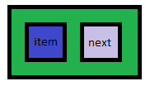
Linked List(cont.)
Node
The elements in link list are called nodes.
Node is a non-primitive data type to hold the item and next it in.
Step 1:

Slide 7


Linked List(cont.)
Step 2:
START

Slide 8
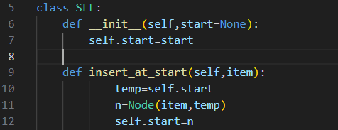
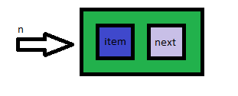
Linked List(cont.)
Step 3

Slide 9
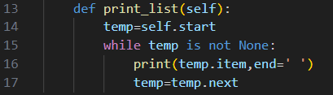
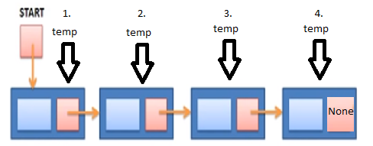
Linked List(cont.)
Step4

Slide 10
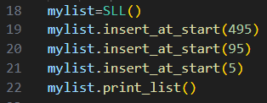
Linked List(cont.)
Instant creation and calling functions:

